Slide 1
Development of an AI tool to identify teeth from 3D imaging
Presented by
Peter Ka Wing Cheng
Master of Data Science
School of Computer Science

Slide 2
Content
Background
Objectives
Related work
Data Preparation
Methodologies
Results
Discussion
Conclusion

Slide 3
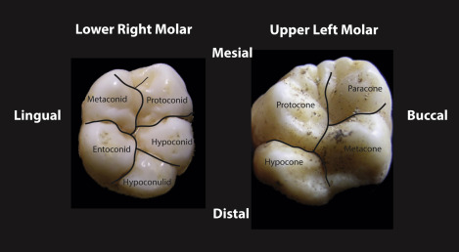
Background
In dentomaxillofacial radiology, a tooth has many different anatomical and morphological features
AI tools to precisely identify 3D features from X-ray dental CT are rare
Tooth morphology is a difficult topic for the students
The lack of 3D model applications hampered the development of online learning tools in tooth morphology
an important mean for student’s self-directed learning
Plastic teeth teaching and learning
lack the variations observed with extracted human teeth
https://www.sciencedirect.com/science/article/pii/B9780128019665000068

Slide 4

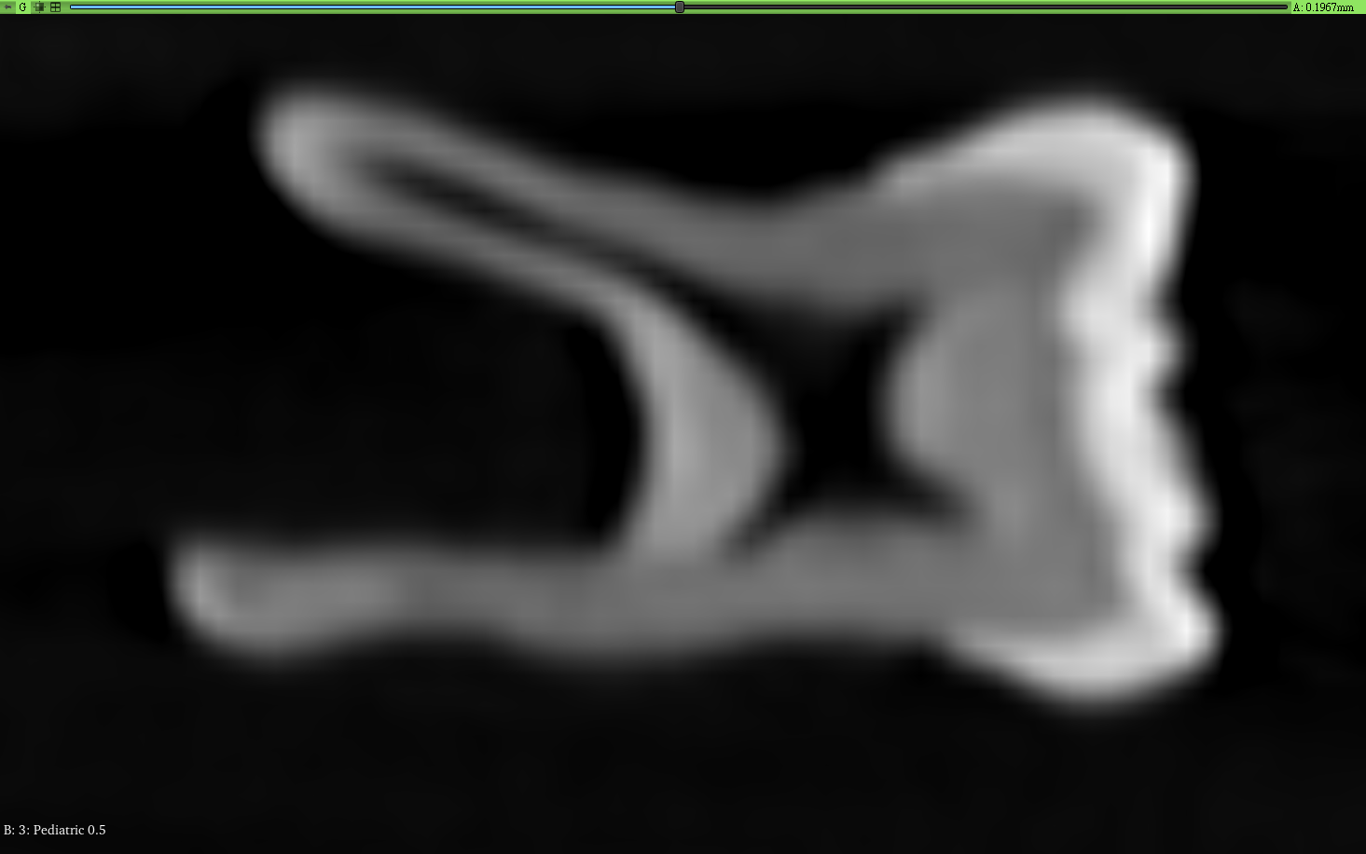
Objectives
Development of an AI tool to identify teeth from 3D imaging
E-learning platform
3D images of real human teeth CT scans
Teeth classification
Structures segmentation
Improve dentistry students’ learning experience

Slide 5
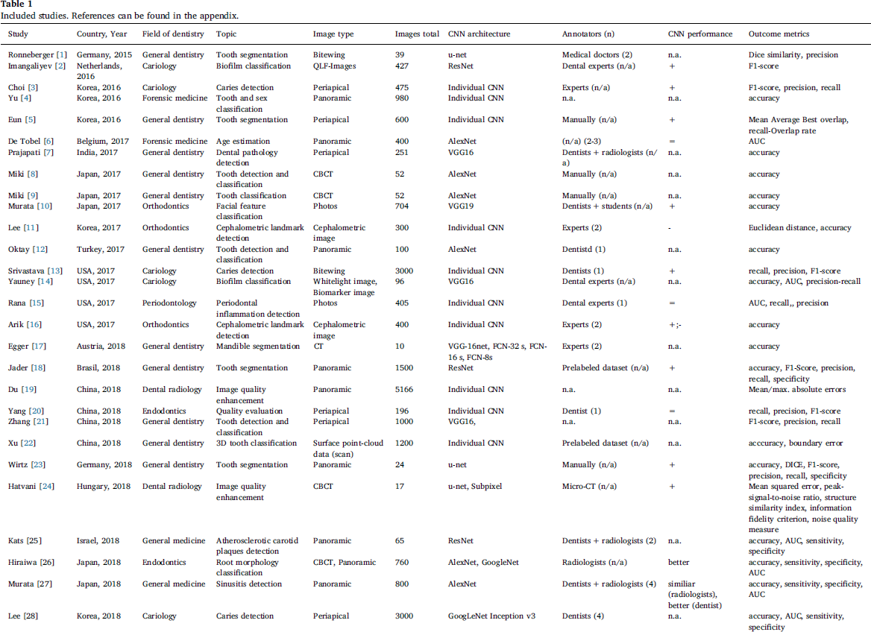
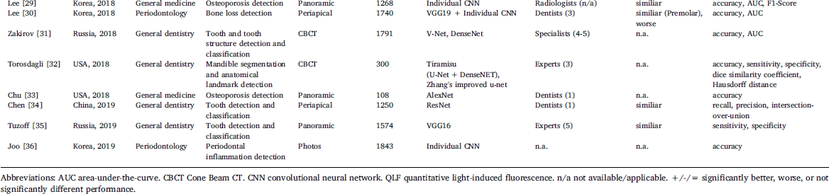
Related work
Convolutional neural network (CNN)
Classification:
AlexNet, VGGNet, ResNet, DenseNet, GoogleNet, …
E.g. Y. Miki et al. 2017
AlexNet 7-classes CBCT
Accuracy: 91%
Segmentation:
Some applications on 2D X-ray images
Not much for 3D CT
Lots of dental applications!
F. Schwendicke, et al., Convolutional neural networks for dental image diagnostics: A scoping review, Journal of Dentistry 91 (2019) 103226

Slide 6
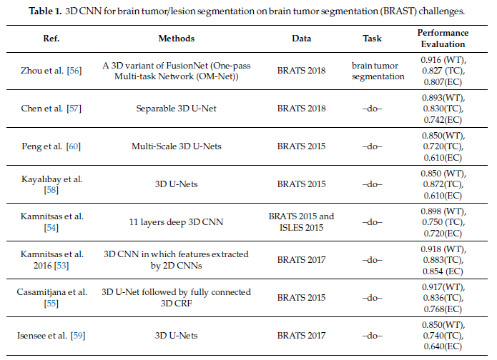
Related work
General 3D medical images segmentation
BRATS Challenges
A lot of 3D U-Nets!
Singh et al., Deep Learning on Medical Images: A Review, Sensors 2020, 20, 5097

Slide 7
Related work
Latest BraTS Result
Brain Tumor AI Challenge (2021) | RSNA
https://www.rsna.org/education/ai-resources-and-training/ai-image-challenge/brain-tumor-ai-challenge-2021
Segmentation Task – 1st Winning Team
nnU-Net for Brain Tumor Segmentation
https://arxiv.org/abs/2011.00848
nnU-Net: a self-configuring method for deep learning-based biomedical image segmentation | Nature Methods
https://www.nature.com/articles/s41592-020-01008-z
Also U-Net’s variations!

Slide 8
Data Preparation
DICOM data
Teeth isolation
Labelling
Data split
Augmentation
Classification

Slide 9
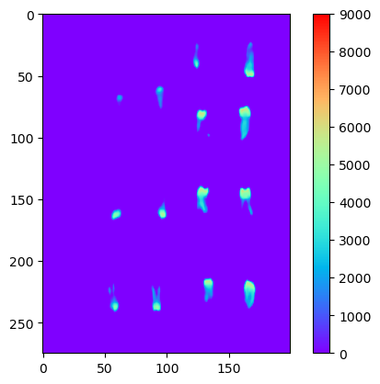
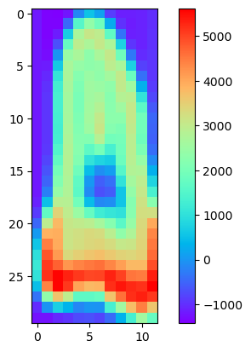
Data Preparation
DICOM data
Isolate individual tooth
Threshold by voxel intensity value: 500
Clear volumes < 1,000 voxels
Isolation: cc3d (connected-components-3d)
Labels
Done by Sydney Dental School
Retain labels with at least 3 counts
Useable data size
360 teeth

Slide 10
Data Preparation
Data split
Training, validation, test
Stratified train_test_split
Preserve labels’ ratio as possible
Label | Training | Validation | Test | Total
maxillary molar | 62 | 32 | 32 | 126
mandibular molar | 47 | 25 | 24 | 96
maxillary premolar | 22 | 12 | 11 | 45
mandibular premolar | 15 | 7 | 8 | 30
maxillary central incisor | 8 | 4 | 4 | 16
mandibular canine | 7 | 4 | 4 | 15
mandibular incisor | 6 | 3 | 4 | 13
maxillary canine | 3 | 2 | 2 | 7
maxillary lateral incisor | 3 | 2 | 2 | 7
maxillary incisor | 3 | 1 | 1 | 5

Slide 11
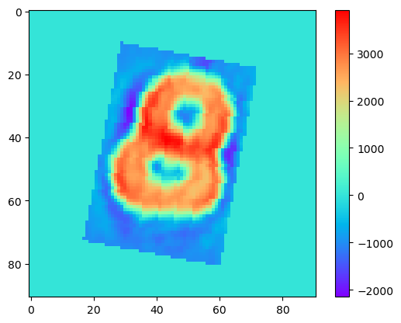
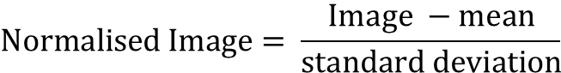
Data Preparation
Data Pre-processing / Augmentation
Training data
Resize: bound by [128, 64, 64]
Padding: to size of [128, 91, 91]
Random rotation: [-90, 90]
No flipping/mirroring
Validation, Test data
Resize: bound by [128, 64, 64]
Padding: to size of [128, 91, 91]
Batch size: 4
Normalisation
Each batch
$$\text{Normalised} \text{Image}= \frac{\text{Image} −\text{mean}}{\text{standard} \text{deviation}}$$

Slide 12
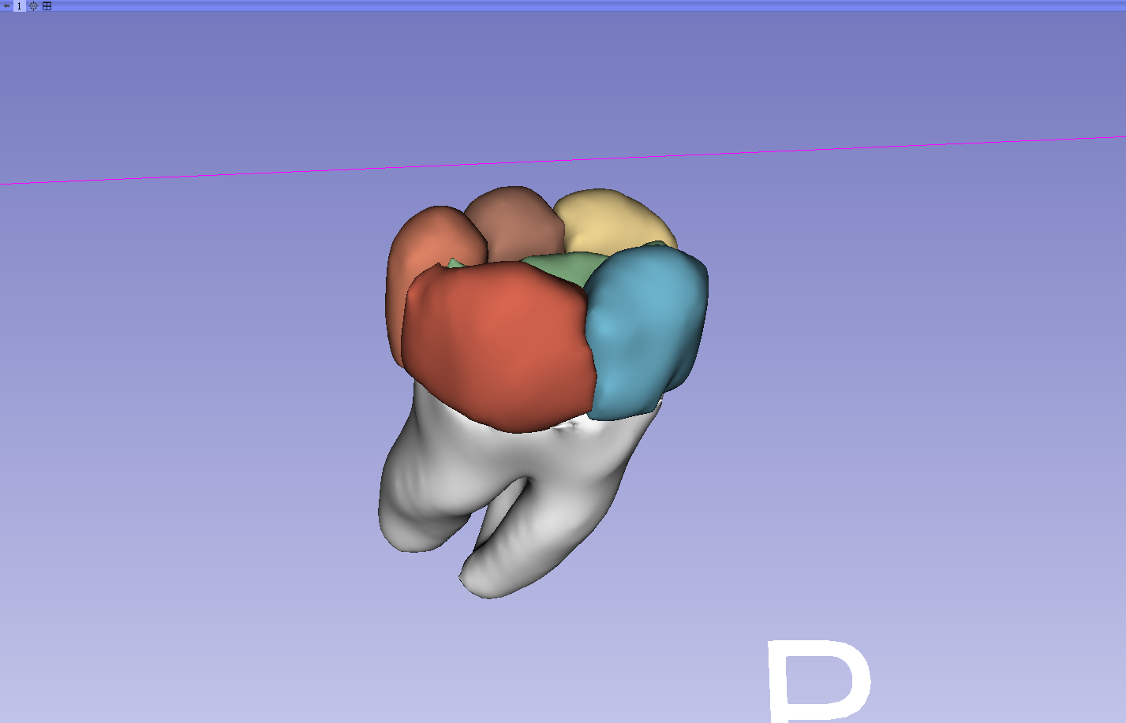
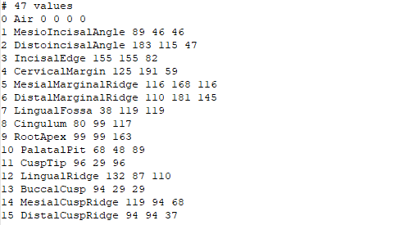
Data Preparation
Segmentation
Labelling
With reference to BraTS
3D Slicer

Slide 13
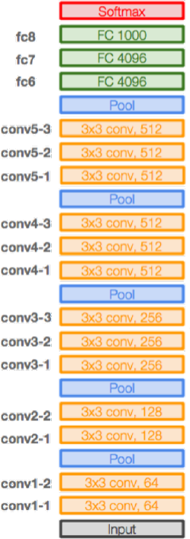
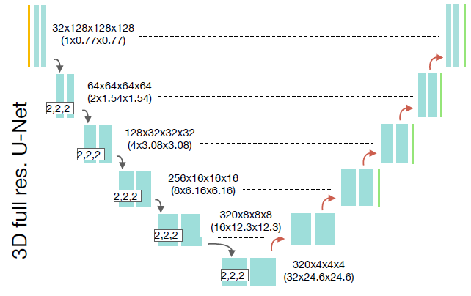
Methodologies
Classification
AlexNet
VGGNet
ResNet
Segmentation
nnU-Net
nnU-Net
VGG16
AlexNet
ResNet

Slide 14
Methodologies
AlexNet, VGGNet, ResNet
CNNs for 2D colour images
3 channels * X * Y
CT images
1 channel * X *Y * Z
Adaption
nn.Conv2d(128, 3, kernel_size=(1, 1), stride=(1, 1), padding=(0, 0), bias=False)
Extract features from height
Reduce dimensions to 3 * X * Y as colour images input
Height

Slide 15
Methodologies
3D AlexNet
nn.Conv2d → nn.Conv3d
nn.MaxPool2d → nn.MaxPool3d
nn.AdaptiveAvgPool2d → nn.AdaptiveAvgPool3d
3D ResNet
VideoResNet
A Closer Look at Spatiotemporal Convolutions for Action Recognition
Requires 3 channels * X *Y * T (or Z)
nn.Conv3d(1, 3, kernel_size=(1, 1, 1), stride=(1, 1, 1), padding=(0, 0, 0), bias=False)

Slide 16
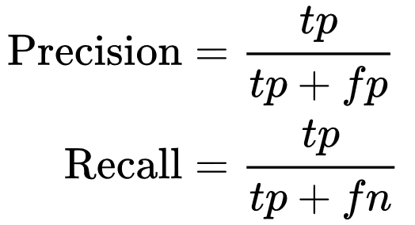
Results
 | Micro F1 Scores
 | Training Data | Validation Data | Test Data
ResNet | 0.863636 | 0.858696 | 0.684783
VGG16 | 0.710227 | 0.771739 | 0.684783
AlexNet | 0.795455 | 0.782609 | 0.673913
3D AlexNet | 0.693182 | 0.836957 | 0.619565
3D ResNet | 0.943182 | 0.902174 | 0.728261
Trials of different models
Without hyper-parameters tuning
Learning rate: 10⁻⁴
Epochs: 30
Save the models at the best validation F1-scores
Pick the best model for hyper-parameters tuning
3D ResNet
 | Macro F1 Scores
 | Training Data | Validation Data | Test Data
ResNet | 0.799432 | 0.684686 | 0.574779
VGG16 | 0.630240 | 0.506027 | 0.486936
AlexNet | 0.687771 | 0.645796 | 0.450561
3D AlexNet | 0.545427 | 0.482550 | 0.383500
3D ResNet | 0.896104 | 0.766879 | 0.575931
Micro: Calculate metrics globally by counting the total true positives, false negatives and false positives.
Macro: Calculate metrics for each label, and find their unweighted mean. This does not take label imbalance into account.
https://scikit-learn.org/stable/modules/generated/sklearn.metrics.f1_score.html

Slide 17
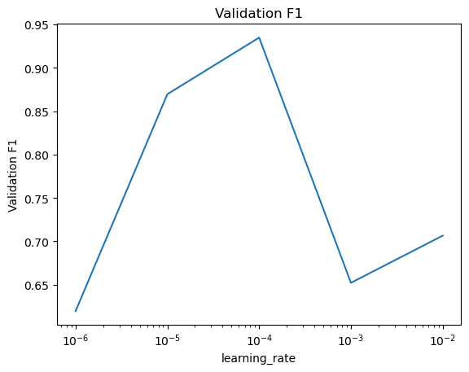
Results
Hyper-parameters tuning
The best learning rate occurs at 10⁻⁴
3D ResNet hyper-parameter tuning

Slide 18
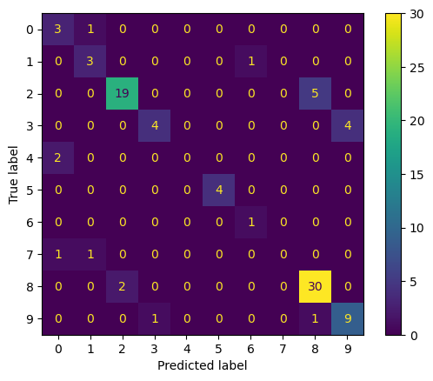
Results
Final re-train data with both training and validation data
Stopped when
Re-training micro F1-score ≥ previous validation F1-score
Test data
Micro F1-score: 0.793478
Macro F1-score: 0.602551
Time: 0.22 s per sample
Confusion matrix on test data

Slide 19
Discussion
2D vs 3D models
3D models performed better than the corresponding 2D models
Although 2D 1x1 convolution can extract height features, it compresses the information
Performance
Final test data micro F1-score is 0.793478
Still have room for improvement

Slide 20
Discussion
Test data
Labels | Precision | Recall | F1-score | Support
mandibular canine | 0.5 | 0.75 | 0.6 | 4
mandibular incisor | 0.6 | 0.75 | 0.67 | 4
mandibular molar | 0.9 | 0.79 | 0.84 | 24
mandibular premolar | 0.8 | 0.5 | 0.62 | 8
maxillary canine | 0 | 0 | 0 | 2
maxillary central incisor | 1 | 1 | 1 | 4
maxillary incisor | 0.5 | 1 | 0.67 | 1
maxillary lateral incisor | 0 | 0 | 0 | 2
maxillary molar | 0.83 | 0.94 | 0.88 | 32
maxillary premolar | 0.69 | 0.82 | 0.75 | 11
Low sample sizes!

Slide 21
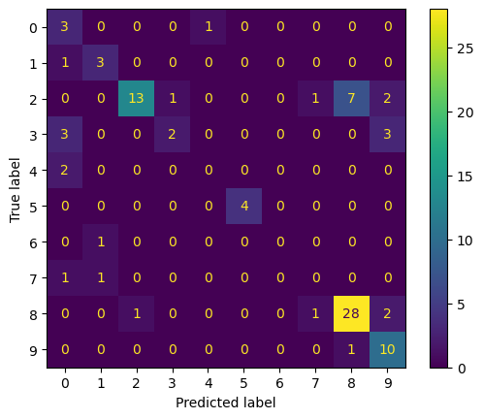
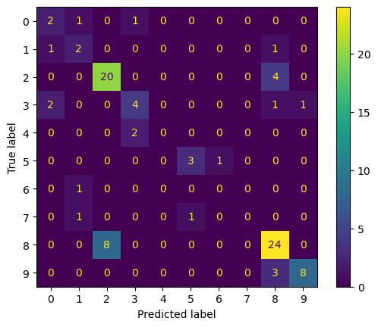
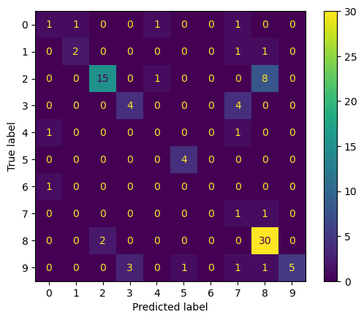
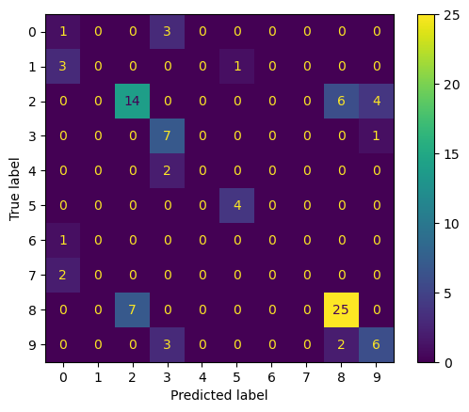
Discussion
Test data
Similar pattern
Weak with low samples
Ensemble Methods
Voting?
Need at least better performance than random guessing
Cannot have significant improvement classes with very low sample sizes
Also difficult for other methods
ResNet
VGG16
AlexNet
3D AlexNet

Slide 22
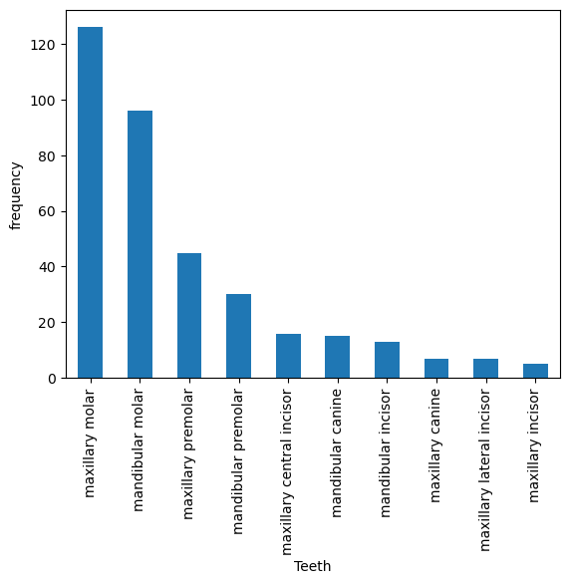
Discussion
Label | Training | Validation | Test | Total
maxillary molar | 62 | 32 | 32 | 126
mandibular molar | 47 | 25 | 24 | 96
maxillary premolar | 22 | 12 | 11 | 45
mandibular premolar | 15 | 7 | 8 | 30
maxillary central incisor | 8 | 4 | 4 | 16
mandibular canine | 7 | 4 | 4 | 15
mandibular incisor | 6 | 3 | 4 | 13
maxillary canine | 3 | 2 | 2 | 7
maxillary lateral incisor | 3 | 2 | 2 | 7
maxillary incisor | 3 | 1 | 1 | 5
A more balanced data set needed!

Slide 23
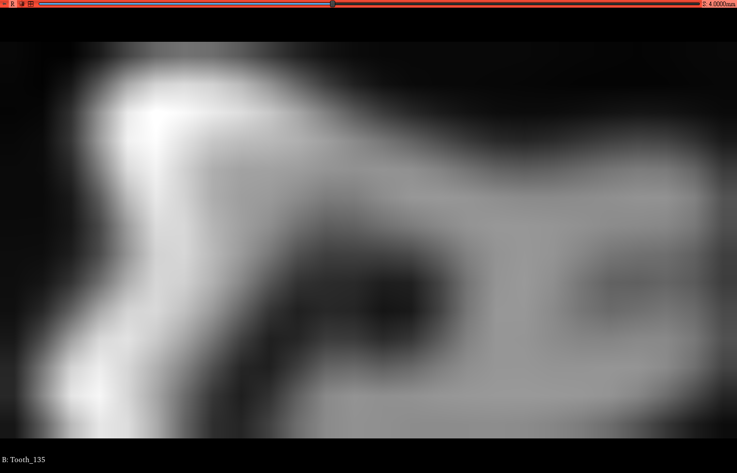
Discussion
Low resolution images
Difficult for segmentation
Difficult for human recognition
Also difficult for machine learning

Slide 24
Conclusion
Developed teeth classification model using video (3D) ResNet
Model micro F1-score is 0.793478 on test data
Testing time is 0.22 s per sample
A more balanced data set is needed for better performance
Segmentation task for identifying morphological and anatomical features of teeth
Can be assisted by the classification model
Developed framework for labelling

Slide 25
Conclusion
Future work
Collection of higher resolution CT scans with a more balanced types of teeth
Try methods (e.g., weighted loss, sampling) for data imbalance
Continue labelling on teeth’s morphological and anatomical features
Apply semi-supervised learning on teeth classification models

Slide 26
Q&A Session

Slide 27
Thank you!

